Slide 1
Confidence Intervals in Data Science
Topics to be covered:
What is Confidence Intervals?
Margin of Error
Z-Score
T-Score & Student’s T Distribution
Dependent Samples, Two Mean Test
Independent Samples, Two Mean Test
Sehrish Aqeel
www.aisciences.io

Slide 2
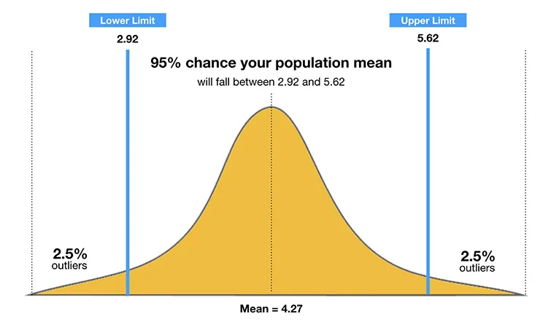
Confidence Interval
A confidence interval displays the probability that a parameter will fall between a pair of values around the mean.
Confidence intervals measure the degree of uncertainty or certainty in a sampling method.
They are most often constructed using confidence levels of 95% or 99%.

Slide 3
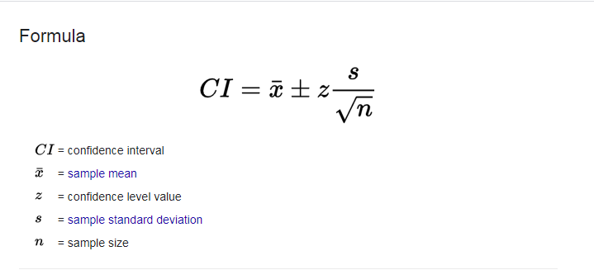
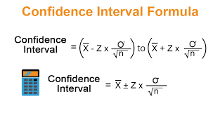
Confidence Interval

Slide 4
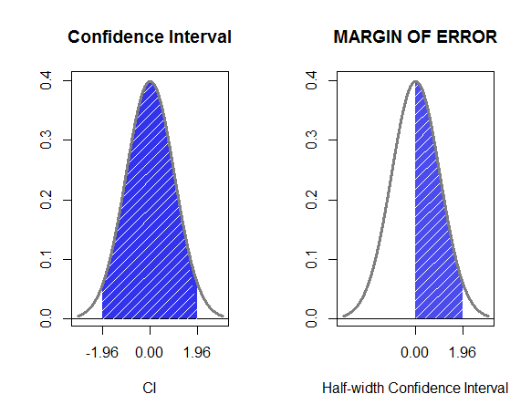
Margin of Errors
A margin of error tells you how many percentage points your results will differ from the real population value.
For example, a 95% confidence interval with a 4 percent margin of error means that your statistic will be within 4 percentage points of the real population value 95% of the time.
More technically, the margin of error is the range of values below and above the sample statistic in a confidence interval. The confidence interval is a way to show what the uncertainty is with a certain statistic (i.e. from a poll or survey).

Slide 5
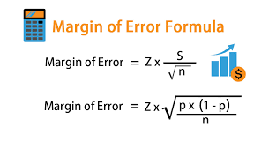

Slide 6
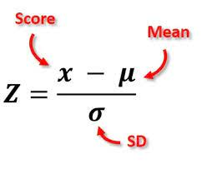
Z- Scores
A Z-score is a numerical measurement that describes a value's relationship to the mean of a group of values.
Z-score is measured in terms of standard deviations from the mean.
If a Z-score is 0, it indicates that the data point's score is identical to the mean score.

Slide 7
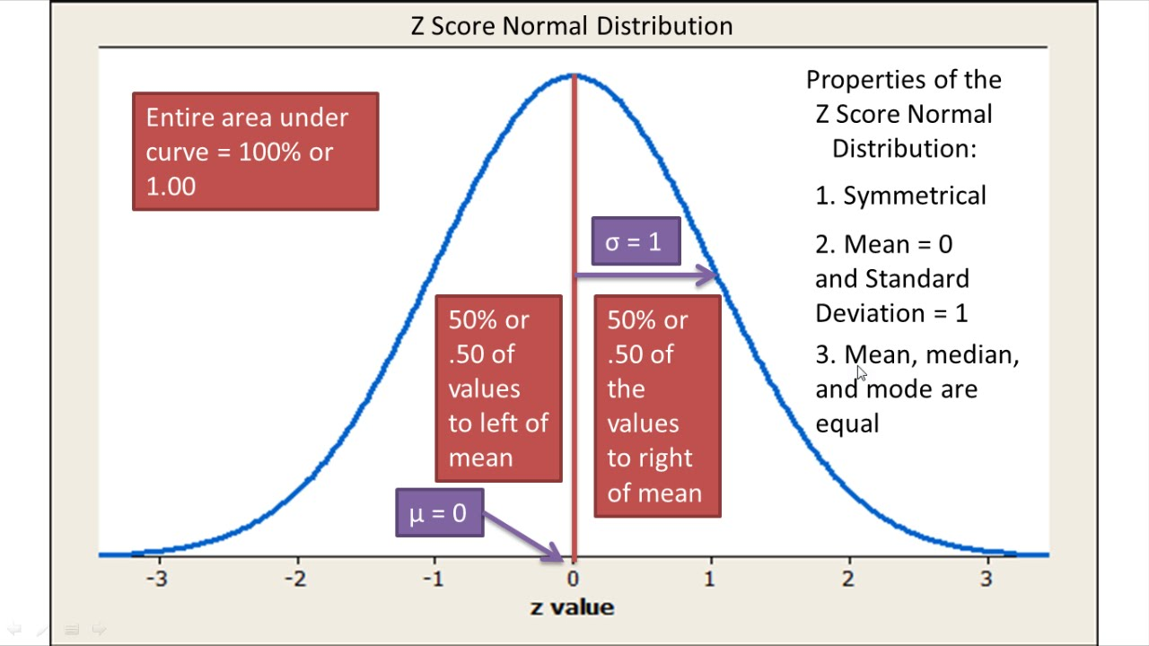

Slide 8
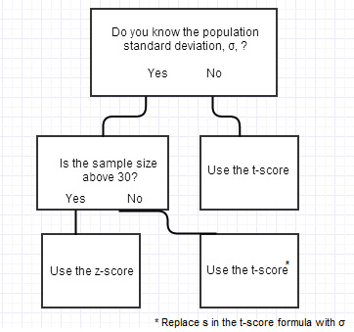
T Score

Slide 9
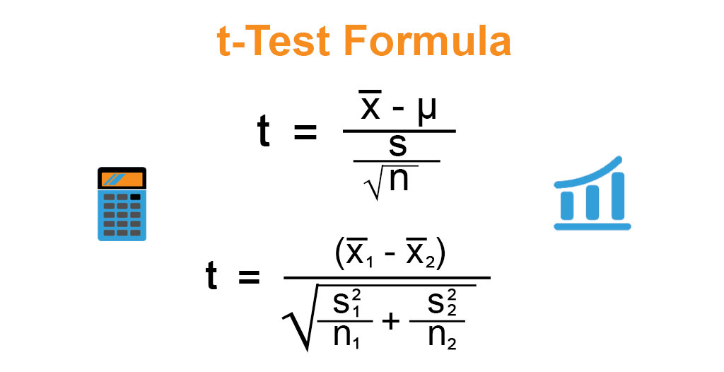
T Score
Like z-scores, t-scores are also a conversion of individual scores into a standard form. However, t-scores are used when you don’t know the population standard deviation; You make an estimate by using your sample.

Slide 10
Student's t-distribution
Student's t-distribution (or simply the t-distribution) is any member of a family of continuous probability distributions that arise when estimating the mean of a normally distributed population in situations where the sample size is small and the population's standard deviation is unknown.
It was developed by English statistician William Sealy Gosset under the pseudonym "Student".
The t-distribution is symmetric and bell-shaped, like the normal distribution. However, the t-distribution has heavier tails, meaning that it is more prone to producing values that fall far from its mean.

Slide 11
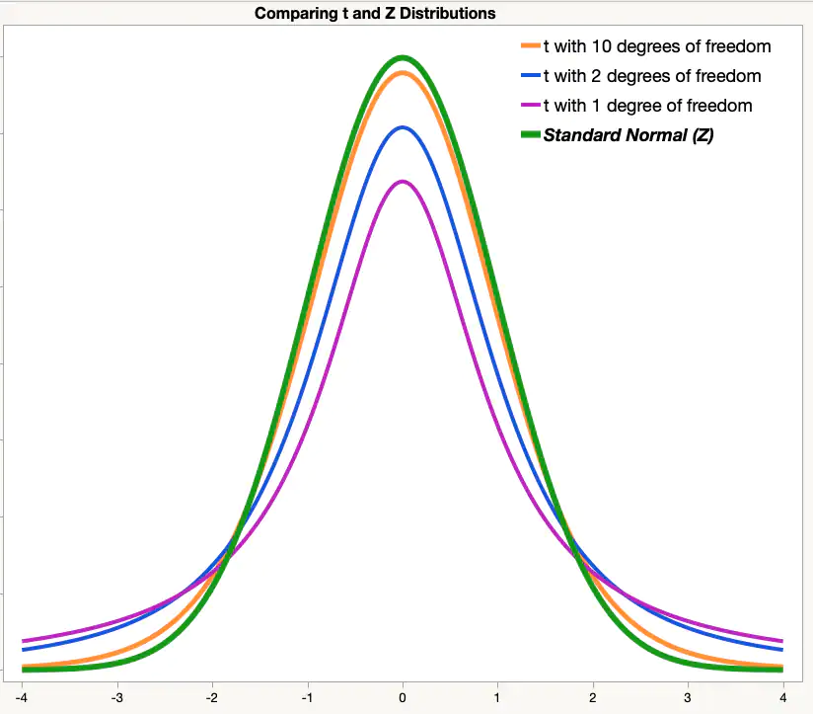

Slide 12
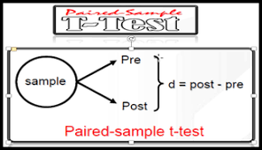
Dependent Sample Two Mean Test
The paired sample t-test, sometimes called the dependent sample t-test, is a statistical procedure used to determine whether the mean difference between two sets of observations is zero.
In a paired sample t-test, each subject or entity is measured twice, resulting in pairs of observations.
Suppose you are interested in evaluating the effectiveness of a company training program. One approach you might consider would be to measure the performance of a sample of employees before and after completing the program, and analyze the differences using a paired sample t-test.

Slide 14
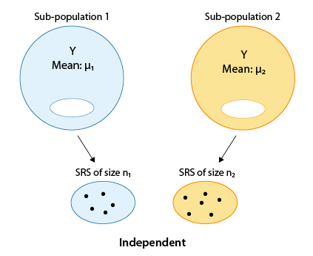
Independent Sample Two Mean Test

Slide 15
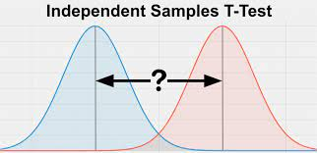
Independent Sample Two Mean Test
A two-sample T-test is defined as statistical hypothesis testing technique in which two independent samples are compared to determine if the means of two populations are statistically different.
The two-sample T-test is used when the standard deviations of the populations to be compared are unknown and the sample size is small.
The two-sample T-test is used when the two samples are independent and have normal distributions.

Slide 16
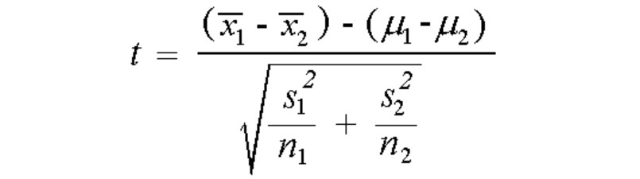
Independent Sample Two Mean Test

